Slide 1



Michael Cabrera, Pamela Cabrera,
Chainey Cathemer, Matthew Duran Jr.,
Draylin Gordon, Thinh Nguyen, Delaine Reeves
Mentor: Dr. Pryor
Instructor: Matthew Katterman

Slide 2
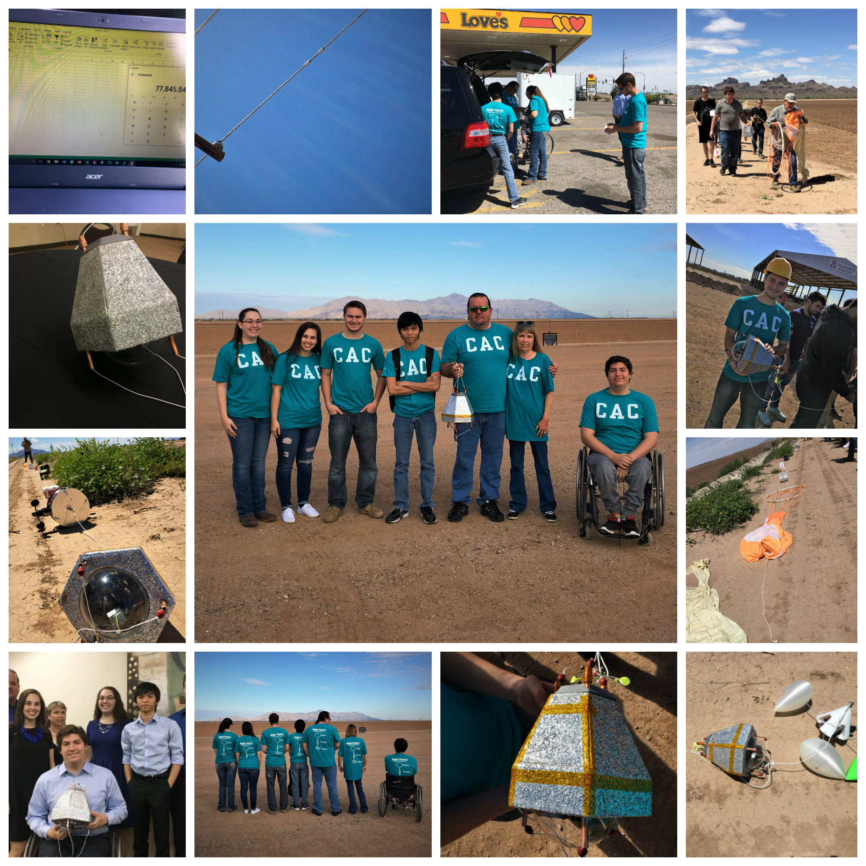
Balloon 2 Launch
and Recovery Spring 2017

Slide 3
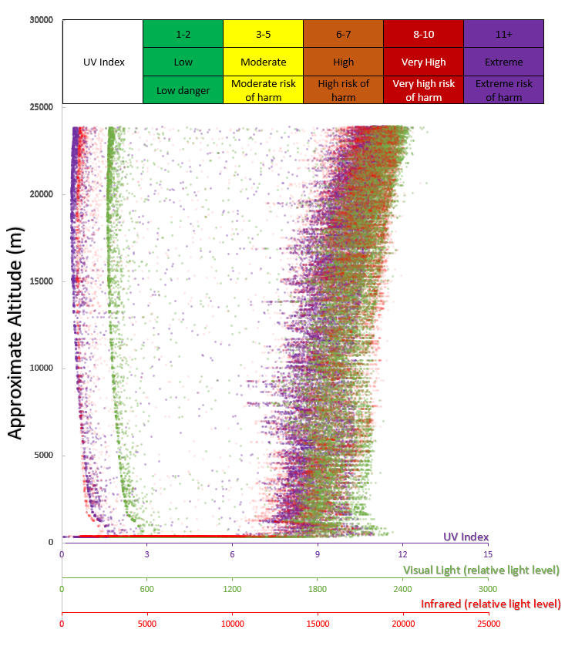
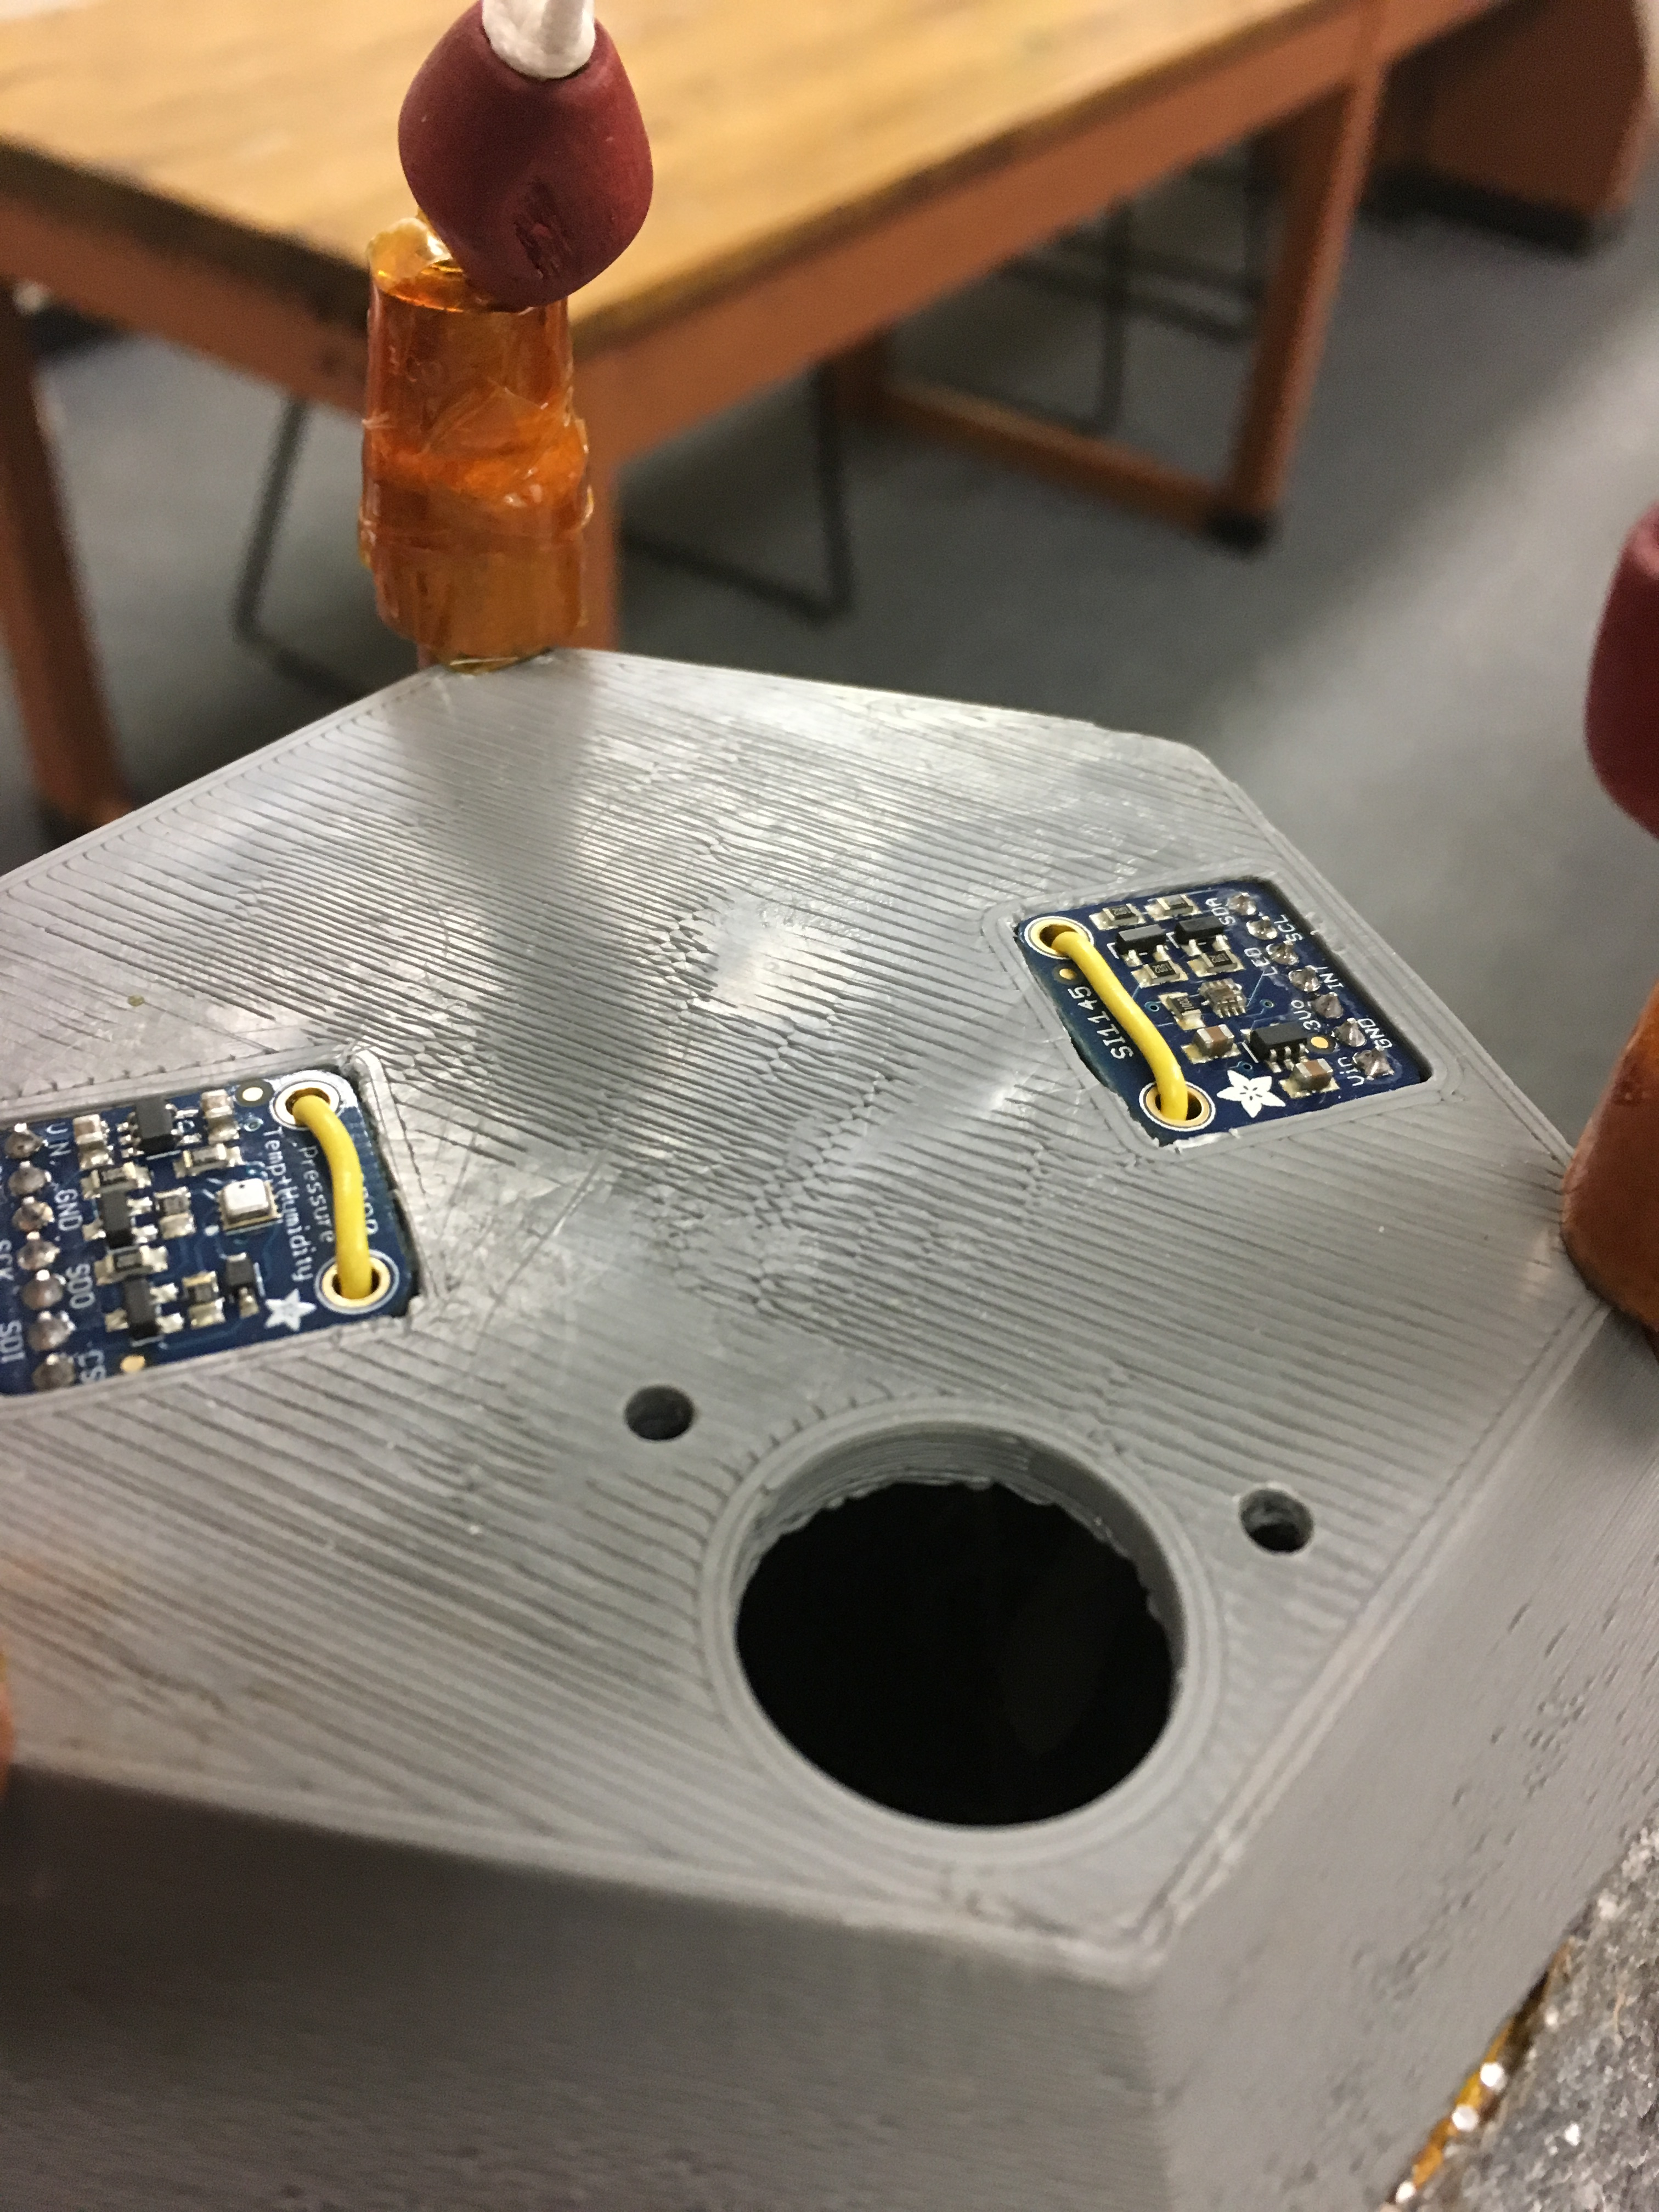
This chart shows the UV (purple), Visual light (green), and Infrared (red) changing slightly as we get higher into the atmosphere.
We used sensors BME280 and SI1145
Off Sun
On Sun

Slide 4
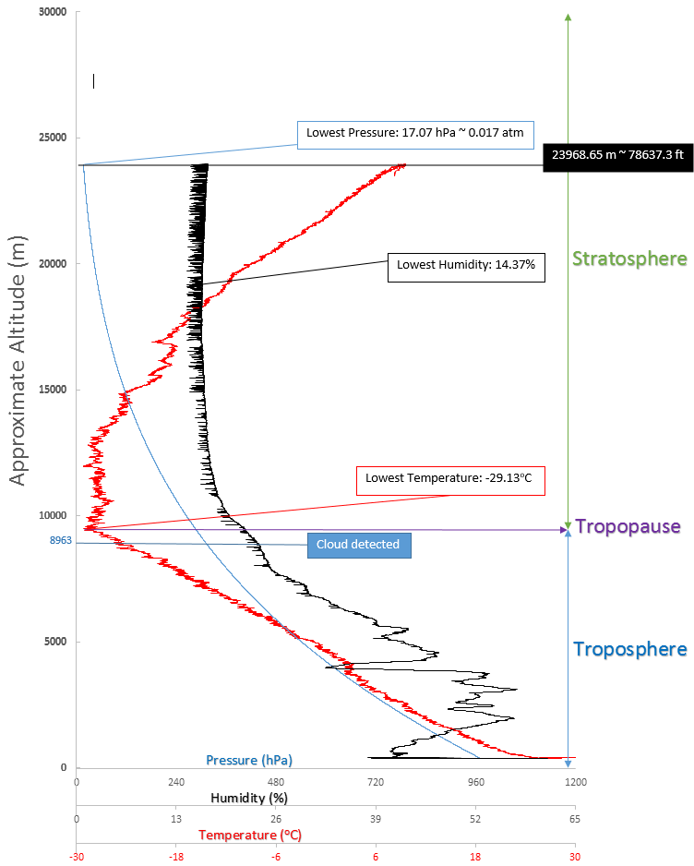
This chart shows how Pressure (blue), Humidity (black), and Temperature (red) change as the payload rises in Altitude.

Slide 5

Video Series from Our Payload

Slide 6
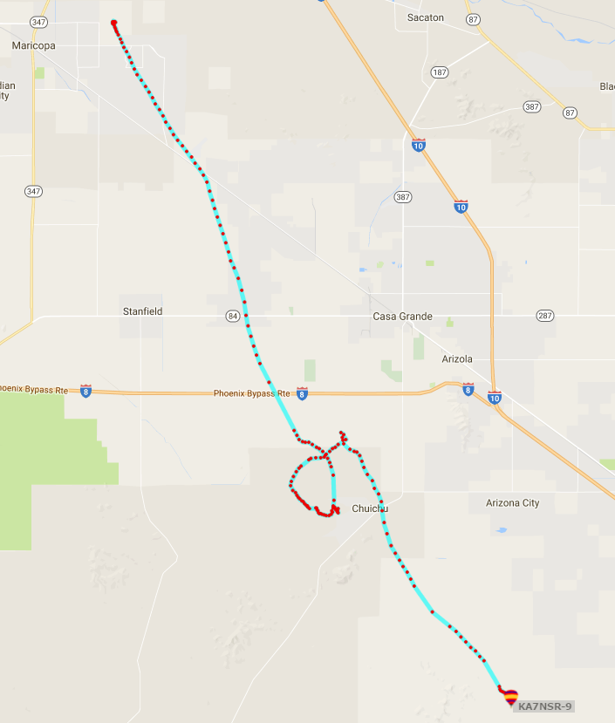
Launch
This is the path that Balloon 2 followed from launch at Maricopa Agriculture Center to South of Arizona City on a farm road where it landed.
Cloud layer in video 29,000
Tropopause
Balloon Pop
93,166 ft.
Landing

Slide 7
Acknowledgements
Jack Crabtree
ANSR Volunteers
Professor: Dr. Pryor
Instructor: Matthew Katterman
Susan Brew
Arizona Space Grant Consortium
Fellow Team Members

Slide 8
Thank You!
Any Questions?

